Slide 1
AJAX BASIC (Asynchronous JavaScript And Xml)
DANNY YEN/THE SHORTCUT

Slide 2
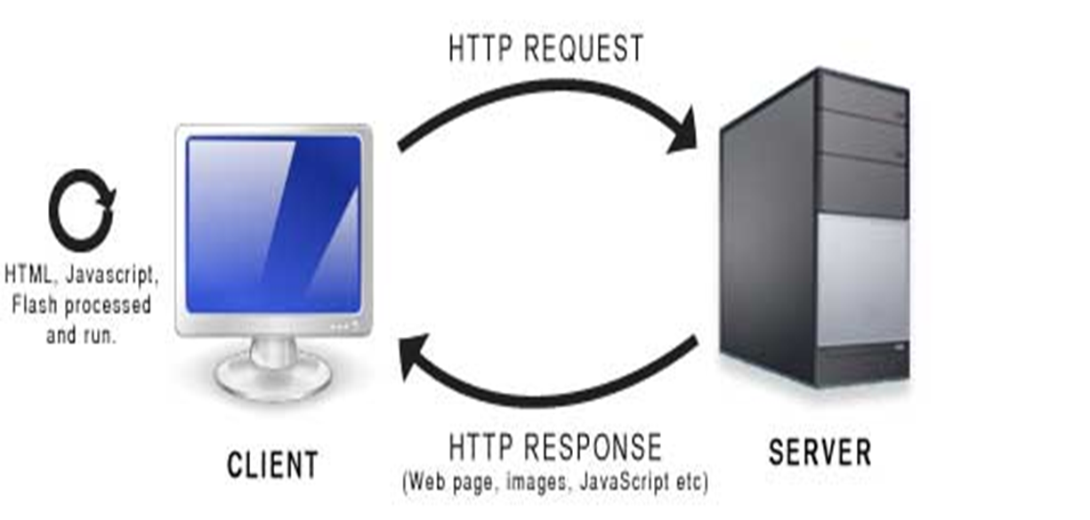
Asynchronous JavaScript And XML is not a programming language, uses a browser to build an XMLHttpRequest object (to request data from a web server) and JavaScript and HTML DOM (to display or use the data). https://www.w3schools.com/whatis/whatis_ajax.asp

Slide 3
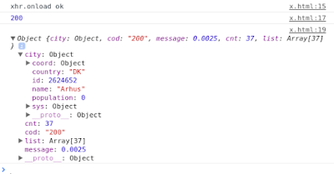
XMLHttpRequest (xhr) Uses XMLHttpRequest (XHR) objects to interact with servers and retrieves data from a URL. The object returns in JSON format and is used with JavaScript Runtime to display in the browser. https://developer.mozilla.org/en-US/docs/Web/API/XMLHttpRequest

Slide 4
XMLHttpRequest.onreadystatechange An EventHandler that is called whenever the readyState attribute changes. XMLHttpRequest.readyState Returns an unsigned short, the state of the request. XMLHttpRequest.response Returns an ArrayBuffer, Blob, Document, JavaScript object, or a DOMString, depending on the value of XMLHttpRequest.responseType, that contains the response entity body. XMLHttpRequest.responseText Returns a DOMString that contains the response to the request as text, or null if the request was unsuccessful or has not yet been sent. https://developer.mozilla.org/en-US/docs/Web/API/XMLHttpRequest

Slide 5
var request = new XMLHttpRequest(); request.onreadystatechange = function () { var DONE = this.DONE || 4; if (this.readyState === DONE){ alert(this.readyState); } }; request.open('GET', 'somepage.xml', true); request.setRequestHeader('X-Requested-With', 'XMLHttpRequest'); request.send(null); v
After the open method the readyState property of the XMLHttpRequest object should be assigned a value of 1 (OPENED).
After the send method the HTTP the readyState property of the XMLHttpRequest object should be assigned a value of 2 (HEADERS_RECEIVED).
Once the HTTP response content begins to load, the readyState property of the XMLHttpRequest object should be assigned a value of 3 (LOADING).
Once the HTTP response content has finished loading, the readyState property of the XMLHttpRequest object should be assigned a value of 4 (DONE).
https://en.wikipedia.org/wiki/XMLHttpRequest

Slide 6
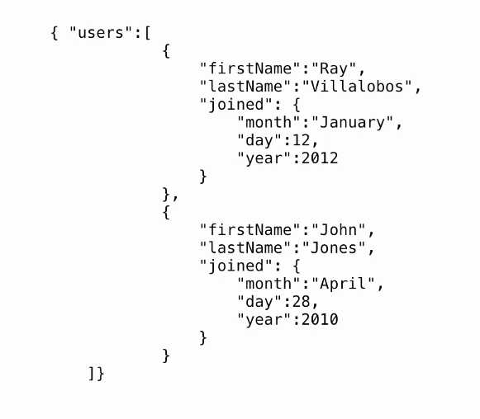
JSON Format

Slide 7
Promises: Fetch JS
The Fetch API provides an interface for fetching resources (including across the network). It is similar XMLHttpRequest, but the new API provides a more powerful and flexible feature set.
The fetch() method takes one mandatory argument, the path to the resource you want to fetch. It returns a Promise that resolves to the Response to that request, whether it is successful or not. You can also optionally pass in an init options object as the second argument (see Request).
https://developer.mozilla.org/en-US/docs/Web/API/Fetch_API

Slide 8
fetch(url)
.then((resp) => resp.json())
.then(function(data) {
let authors = data.results;
return authors.map(function(author) {
let li = createNode('li'),
img = createNode('img'),
span = createNode('span');
img.src = author.picture.medium;
span.innerHTML = `${author.name.first} ${author.name.last}`;
append(li, img);
append(li, span);
append(ul, li);
})
})

